Slide 1
Predicting Peer to Peer Loan Outcomes With
Harmeet Hora
Metis Summer Cohort 2018

Slide 2
The Data
LendingClub.com loan data for all loans accepted in 2015
Assumed independent
Binary outcome (“Full Paid” or “Charged Off”)
300k observations => 10k
Notes:
Lending club is a peer to peer loan website. Loans between 1k and 40k.
Since loan id and customer id was anonymous, each record was considered independent
Reduced the number of outcomes down to “fully paid” or ”charged off”
Started with around 300k usable observations. Due to processing time, took a random sample of 10k data points
A charge-off or chargeoff is the declaration by a creditor (usually a credit card account) that an amount of debt is unlikely to be collected.
After starting with more than 100 features, reduced down to 64

Slide 3
Use Case
Minimize Risk
Focus on precision of “Paid Off”
Profit!
Notes:
You have cash lying around – You want a high return on investment - Using the power of predictive analytics - algorithm can help minimize your risk
Focusing on the precision of loans that are “paid off” based on a variety of different features
Identify loans that will net the highest return while accurately identifying which loans aren’t as “high risk” as initially thought

Slide 4
Results
Algorithm | Precision on Test Set
SVC | 0.92
XGB Classifier | 0.89
k-Nearest Neighbors | 0.87
Decision Tree | 0.87
Linear SVC | 0.86
Random Forests | 0.79
Dummy Classifier | 0.77
Logistic Regression | 0.69
Gaussian Naïve Bayes | 0.65
Notes:
List of algorithms utilized for analysis. As you can see, the Dummy classifier was already quite high as is. Paid off loans is a majority class – so this helps with precision on fully paid.
SVC using radial basis function or rbf kernel with precision of .92 on the original non-oversampled test set and 0.91 with cross validation, making it the highest performing algorithm. Overall it generalizes very well on the dataset.

Slide 5
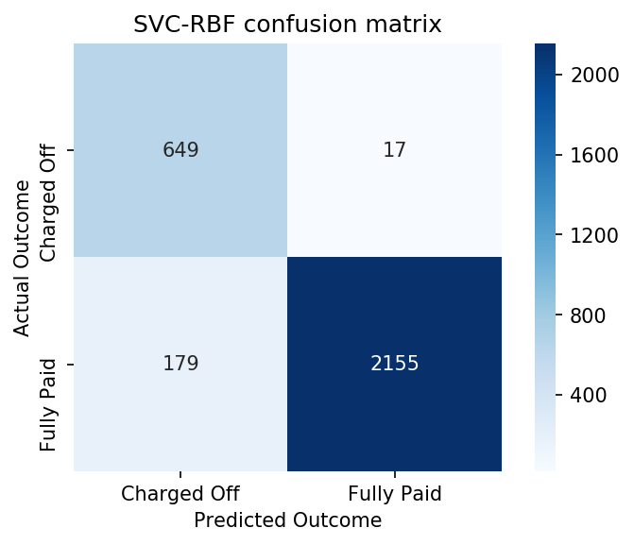

Slide 6
Challenges
Feature Engineering
Non-predictive features
>100 to 63
Optimizing run times

Slide 7
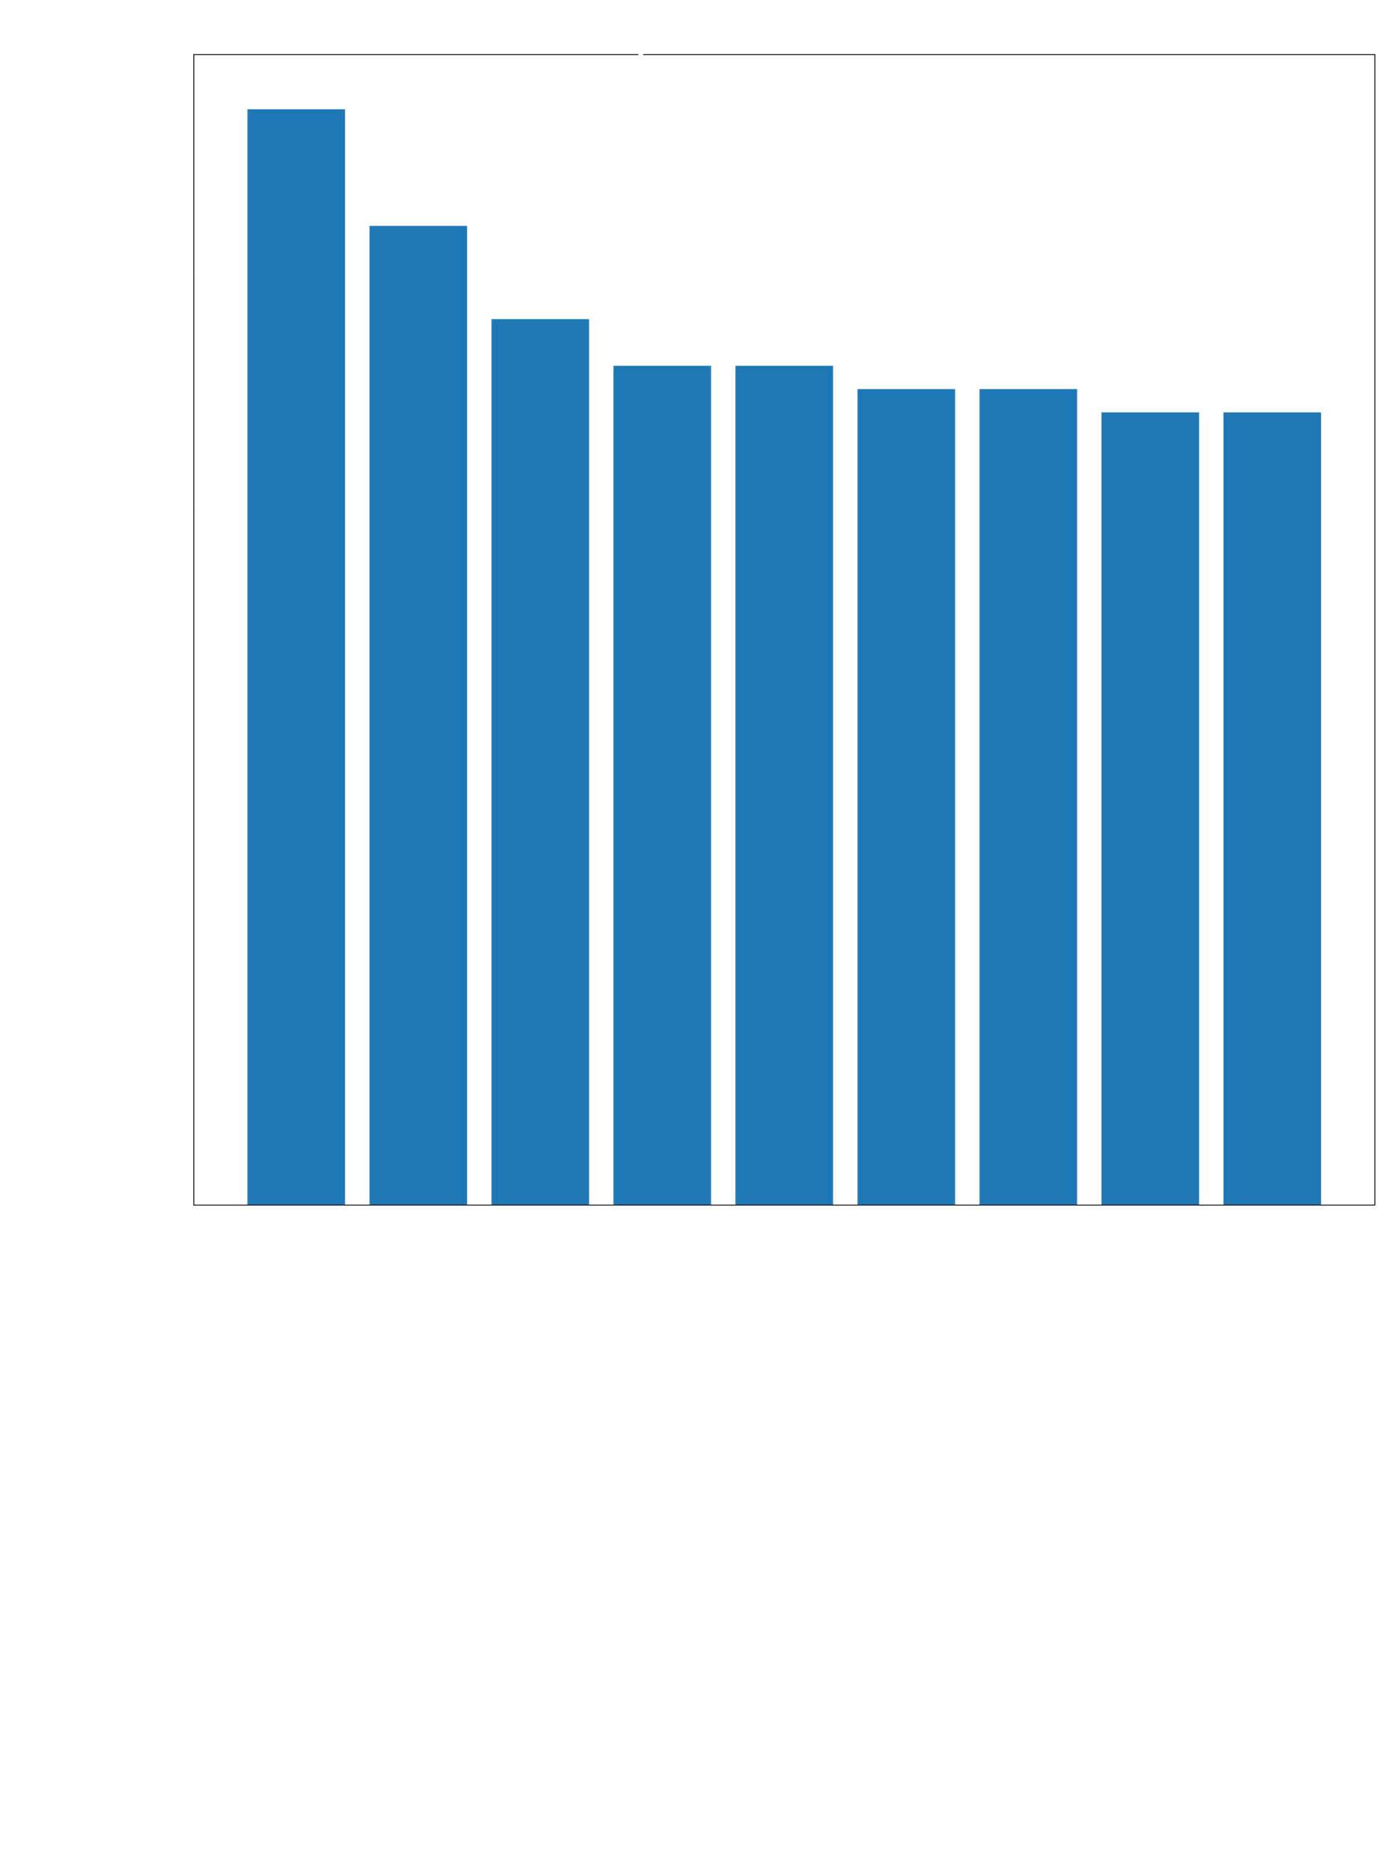
Notes:
Dti is a ratio of total debt payments minus mortgage and loan / monthly income

Slide 8
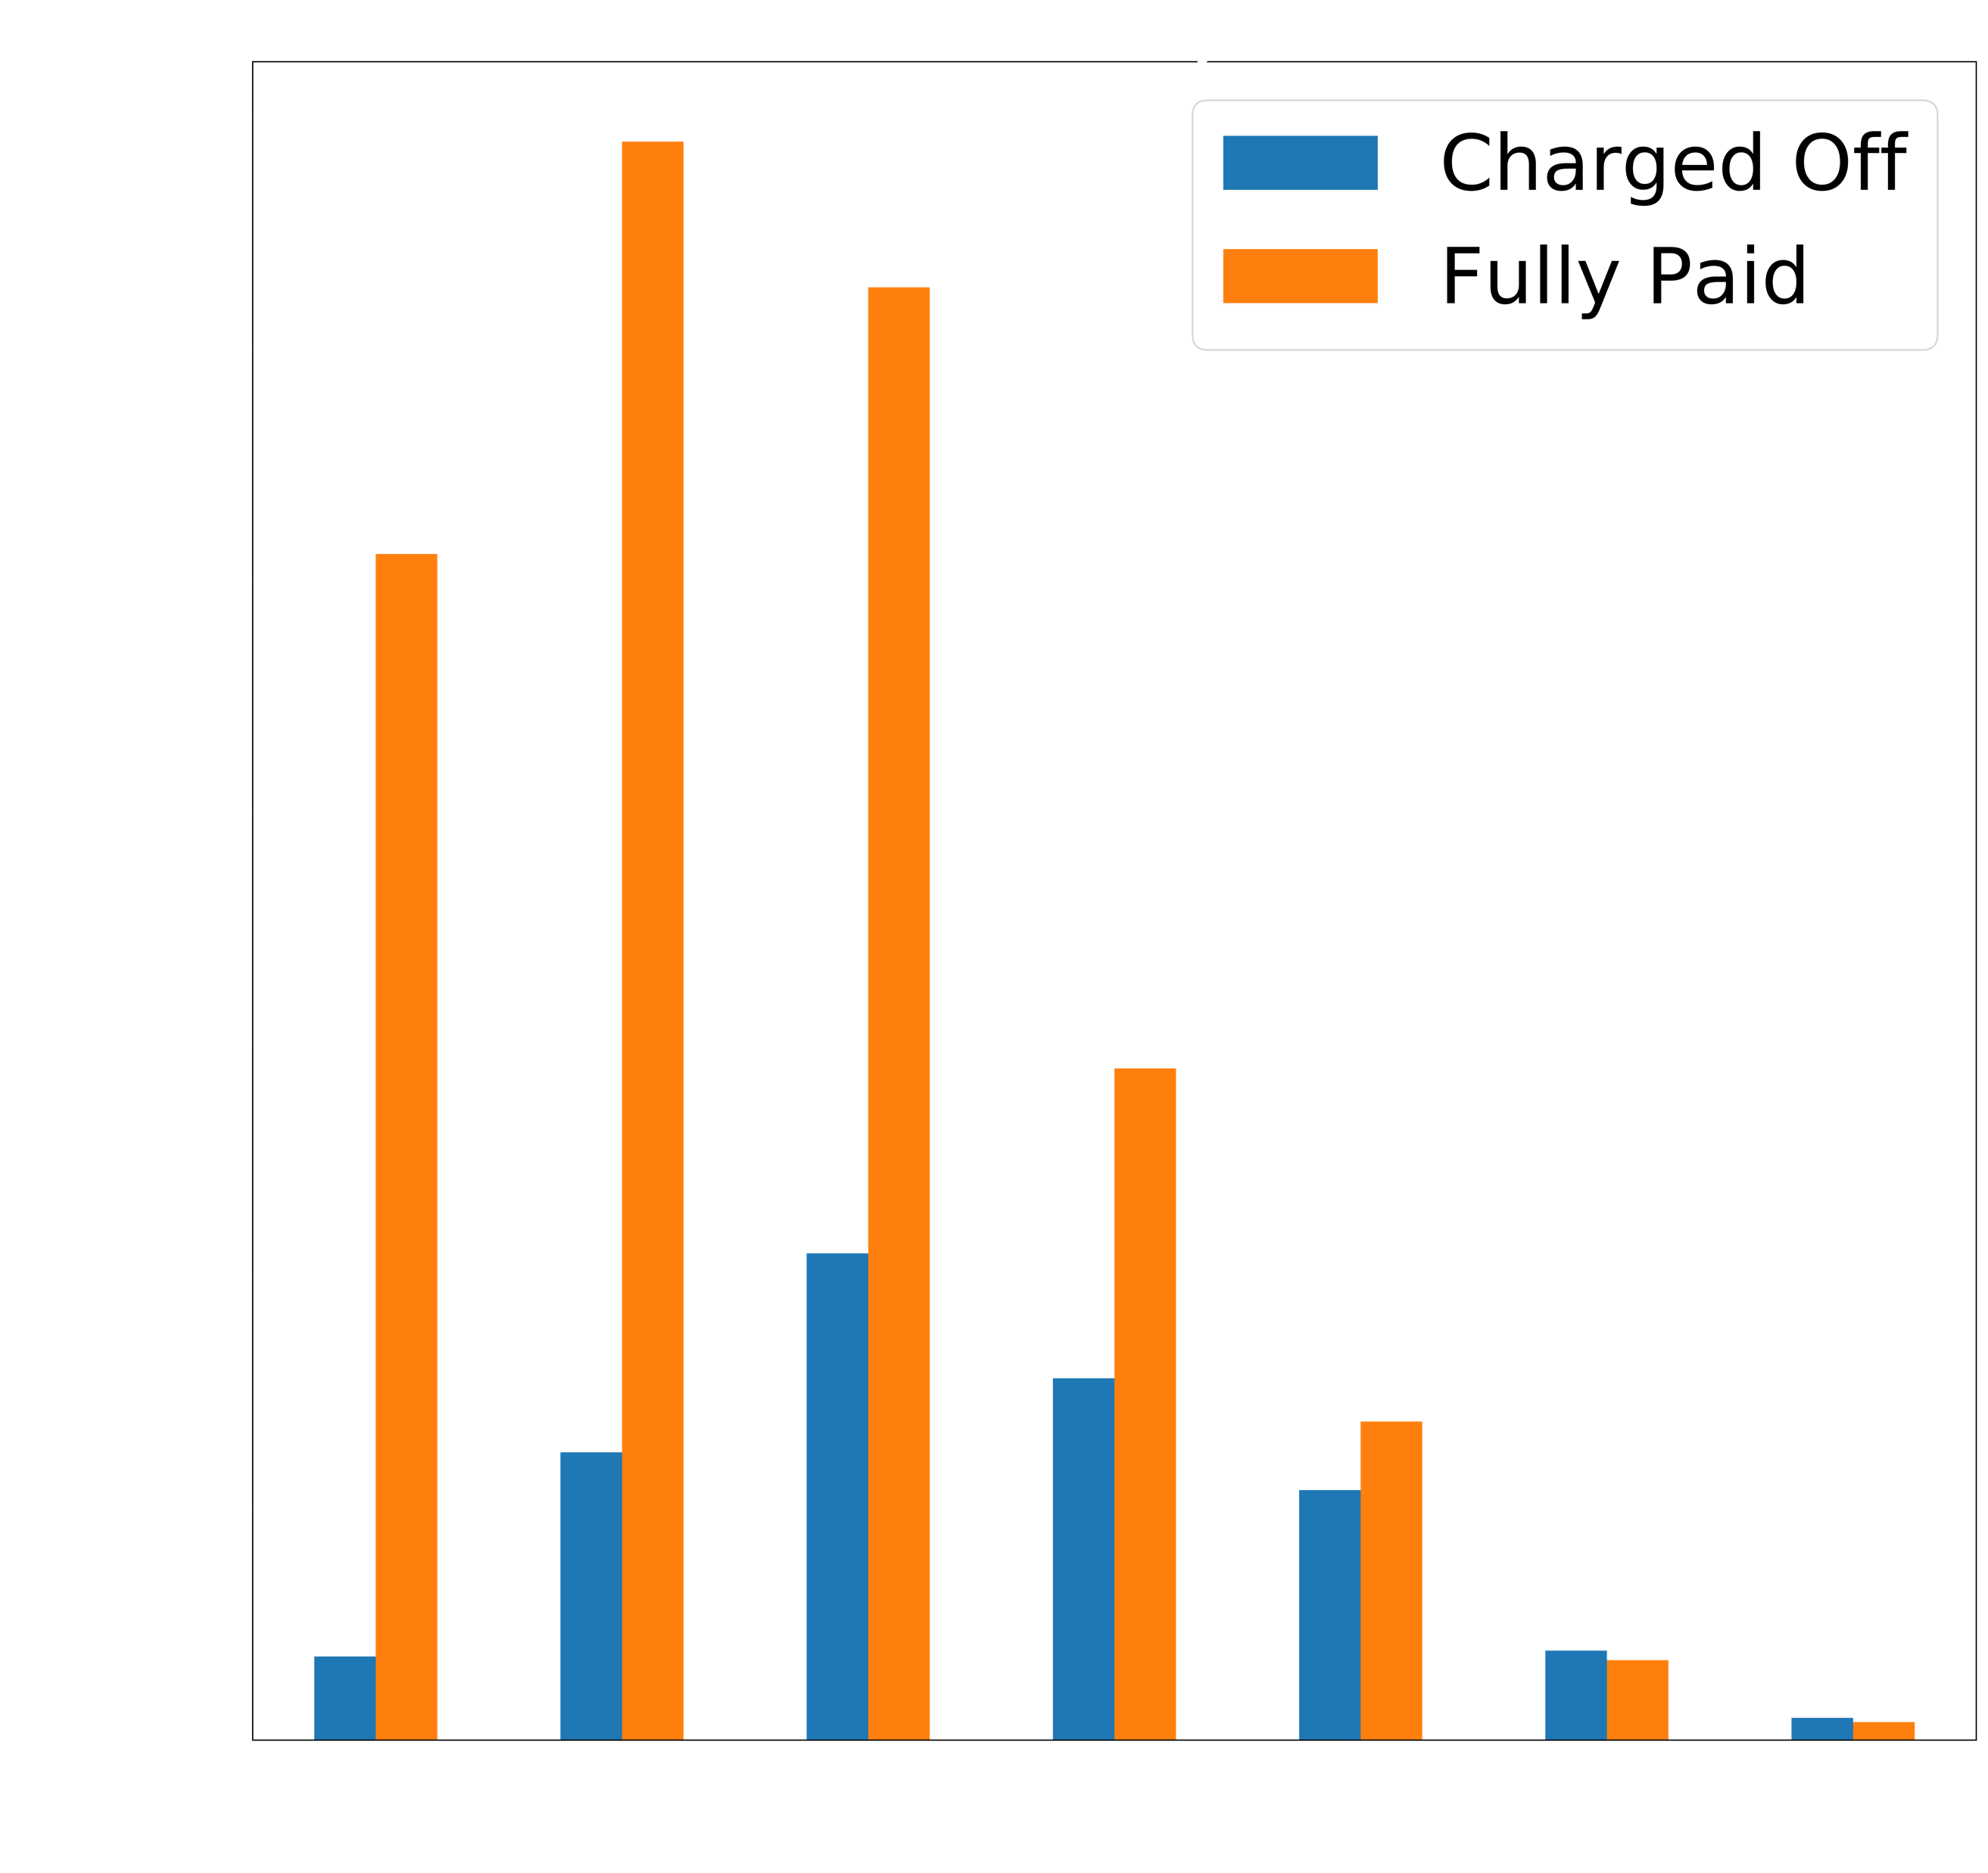
Notes:
Interesting to me how unpredicted the grade assigned by LC was
F’s and G’s performed quite poorly with small sample size, but mid tier loans seem to be good sweep spot for higher interest return

Slide 9
Next Steps
Non-binary classifier (by grade, etc)
Further reduced dimensionality
Deploy in production
Notes:
Dig deeper into classifying perhaps by grade - Leads to better returns on high risk loans
Further reduce dimensionality – 63 features is very difficult for a client to input ie a flask app. Would be great to generalize on simpler conditions
Deploy in production

Slide 10
Thank you.
Notes:
The goal of developing an algorithm for this dataset. Imagine spare cash lying around.

